Slide 1

Banking System
Group 09
ICT 206 1.5 Database Systems and Administration

Slide 2
Contents
01
Introduction
02
Diagrams
03
Database schema
04
Tables
05
Relationships
06
Normalisations Used
07
Assumptions

Slide 3
Introduction
01

Slide 4
What is our system for?
Project background
"ABC Bank" is a rural bank. Recently, it grew rapidly, so it was difficult to record transactions and do banking in the manner currently used.
The main difficulties
Lack of efficiency
Lack of security
Difficulty in keeping and maintaining records.

Slide 5
Main tasks that bank needs to fullfil
Manage Acounts
01
02
Concluding Transactions
03
Provide Security
Create, Update and remove accounts
Cash deposits and withdrawals

Slide 6
Solution

Slide 7
A banking system which can do
Opening of new accounts
Updating existing accounts
Acceptance of Cash Deposits
Issuance of money
Account Deletion
Provide security for accounts and deposits

Slide 8
02
Diagrams

Slide 9
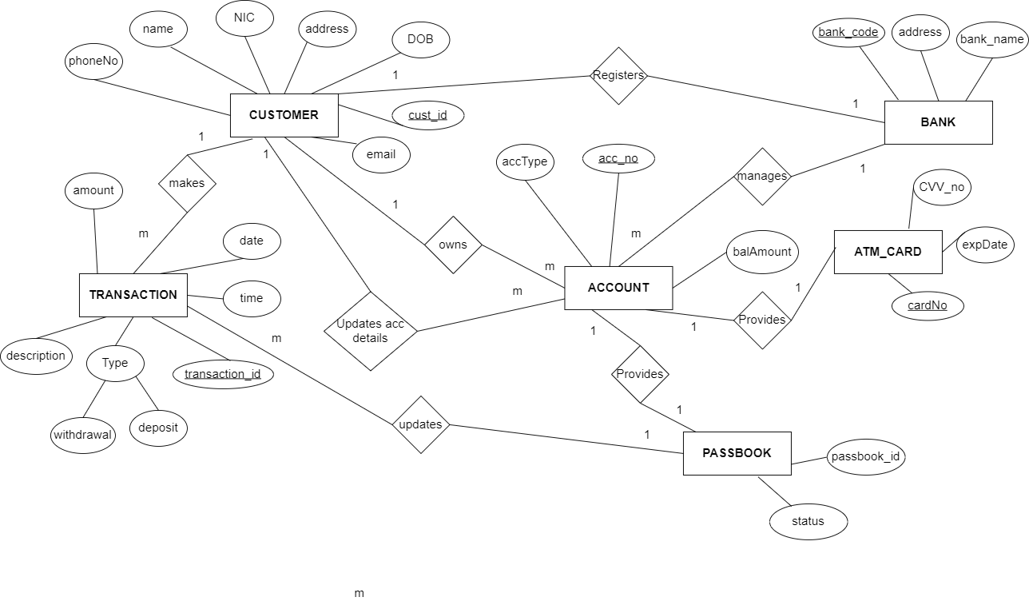

Slide 10
03
Database schema

Slide 11
Table Primary key
Bank bank_code
Customer cust_id
Passbook passbook_id
Account acc_no
Transactions transaction_id
Atm_card card_no

Slide 12
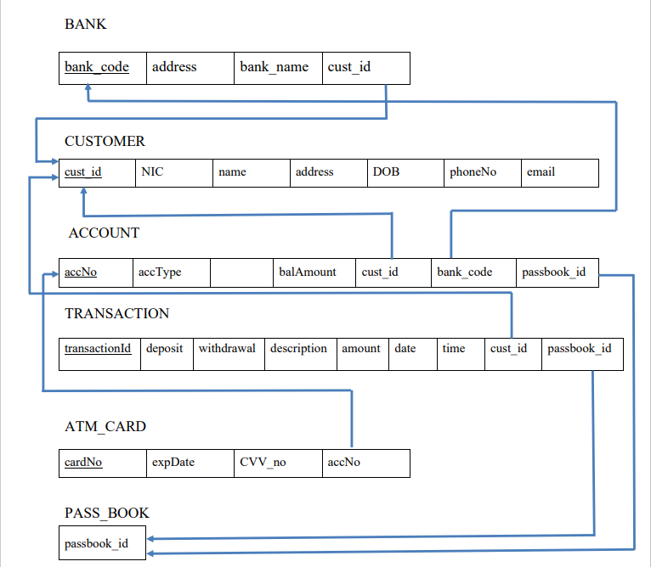

Slide 13
04
Tables

Slide 14
With some data

Slide 15
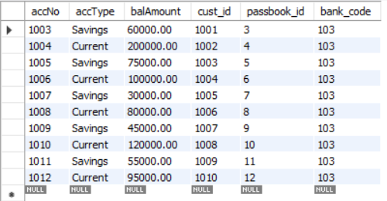
account

Slide 16
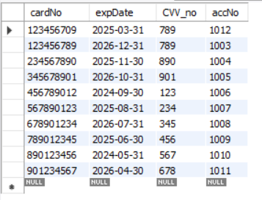
atm_card

Slide 17
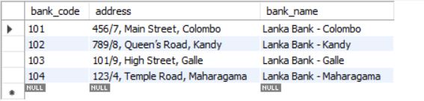
bank

Slide 18
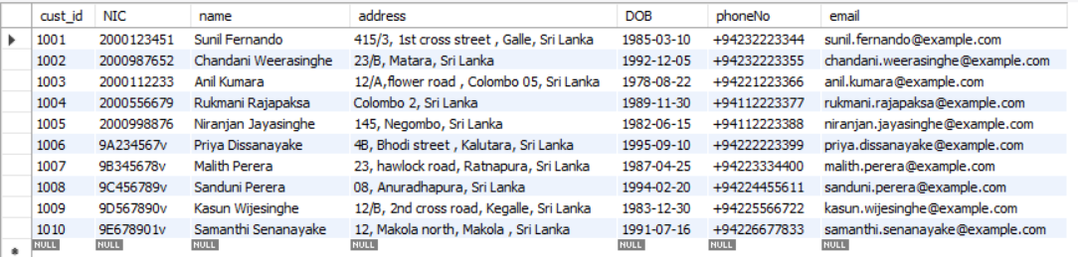
customer

Slide 19
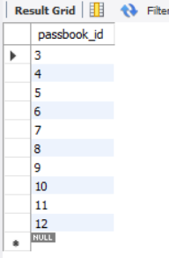
passbook

Slide 20
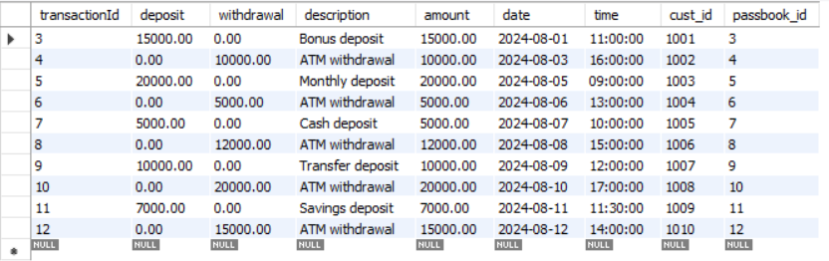
transaction

Slide 21
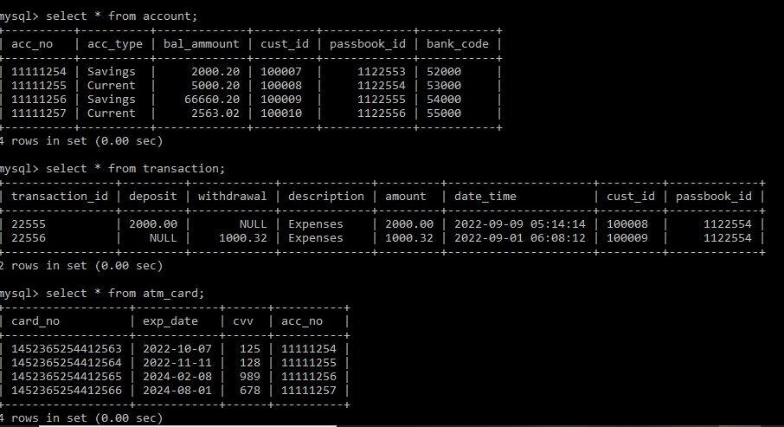
Account
Transactions
Atm_card

Slide 22
Relationships
05

Slide 23
There are 3 types of relationships
1 to 1
1 to Many
Many to Many
Foreign key on any side
Foreign key on the many side
Foreign key on the new table

Slide 25
06
Normalizations

Slide 26
1 NF
2 NF
3 NF
Identify repeating attributes
Remove partial dependencies
Remove the tables dependent on non key attributes

Slide 27
Assumptions
07

Slide 28
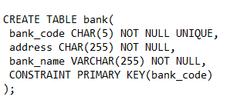
In bank table we introduced bank_code attribute.
In customer table we introduced the Primary key as cust_id
Candidate key NIC
Primary key cust_id

Slide 29
In Passbook table we introduced Status attribute to see the passbook is using at the moment
Status
Active
Inactive
We used CHAR data type for the phone number attribute.
phone_no CHAR(10) NOT NULL,
We allowed the transaction amount to have maximum 13 digits.
amount DOUBLE(15,2),
There will be no loan facility service yet.

Slide 30
Group Members
AS2020980
AS2020975
AS2020973
B.N.S.Peris
S.N.C.Gamage
H.A.S.De Silva
AS2020979
AS2020978
AS2020976
K.D.Y.Niwarthana
L.K.I.Silva
Y.Thananjhayan

Slide 31
Thank You!

